Slide 1
Ecosystems

Slide 2
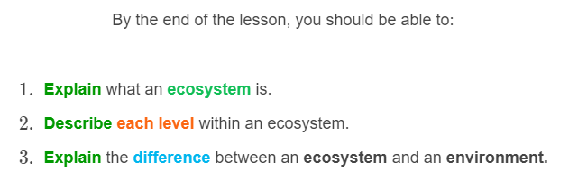
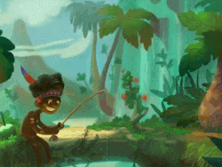

Slide 3
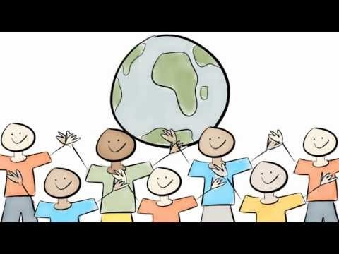

Slide 4
An ecosystem is a system of organisms interacting with each other and their environment.
It is made of a series of levels. We will look at each level, starting from the most complex:
1. | Community
2. | Population
3. | Habitat
4. | Organism

Slide 5
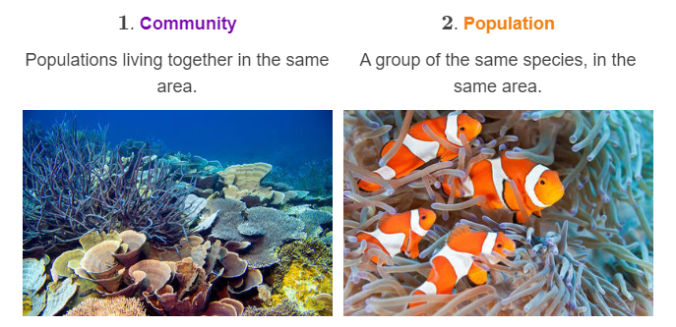
Let's take a look at each level within an ecosystem!

Slide 6
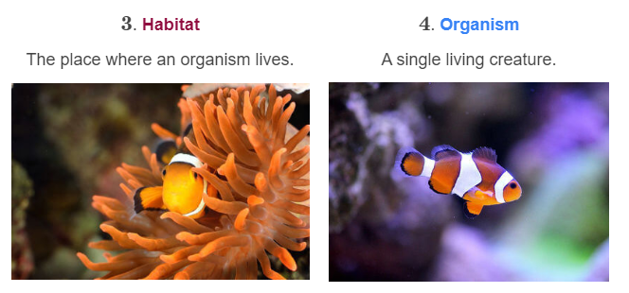

Slide 7
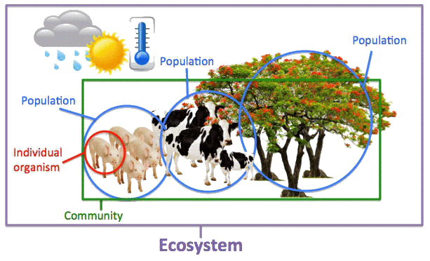
The below picture shows the different components of an ecosystem.
Let's go through each individual component!

Slide 8
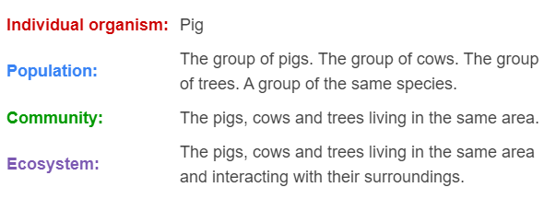
Examples in this ecosystem are:

Slide 9
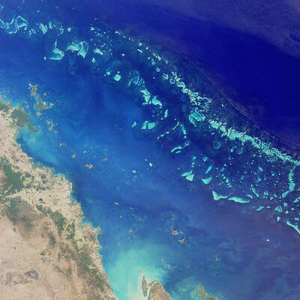
Let's have a look at a real life example of the different levels within an ecosystem!
The Great Barrier Reef is the largest coral reef ecosystem on Earth.

Slide 10
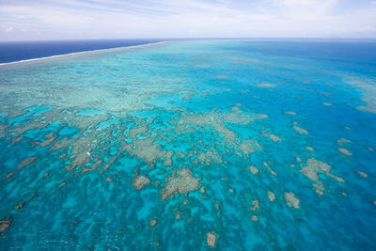
The Great Barrier Reef is situated off the east coast of Australia.
At 348,000 square kilometres, the reef is one of the most diverse natural ecosystems on Earth. It is home to more than 1,500 species of fish!

Slide 11
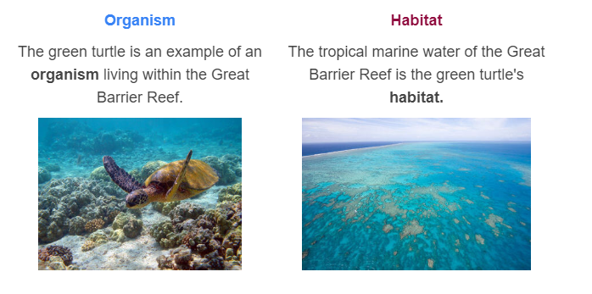

Slide 12
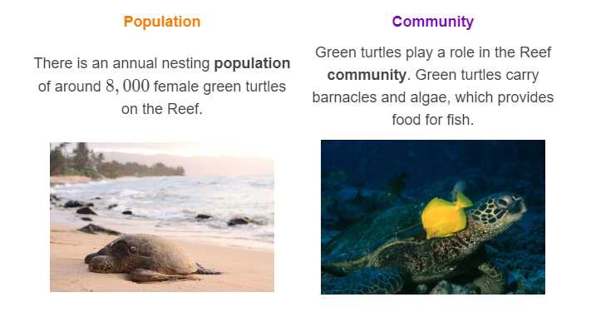

Slide 13
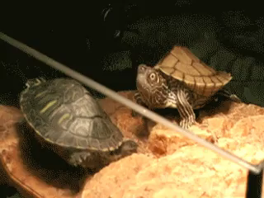
It might surprise you to know that environments and ecosystems are not the same thing!
An ecosystem includes all of the interactions between living and non-living factors in an area.
An environment is the set of living and non-living factors in a given area.

Slide 14
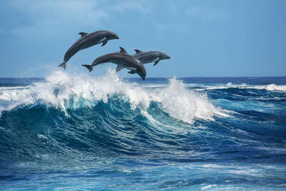
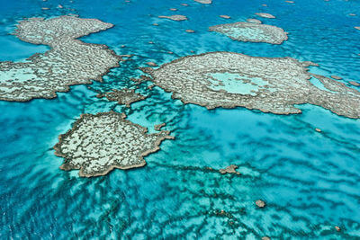
Below is an example of the differences between an environment and an ecosystem.
The Pacific Ocean is an example of an environment.
The Great Barrier Reef is an example of an ecosystem. The ecosystem includes the Pacific Ocean, the organisms that occupy it and how they interact within it.

